Slide 1


Welcome to all

Slide 2
Introduction
Lesson introduction
Teachers introduction
Sarbani Dutta
Assistant teacher
Lamatashi Gps
Bahubal,Hobiganj
Class-Two
Unit-9
Lesson-1
(Life every day)
Lesson-A,B,C
Page-56

Slide 3
Learning outcomes
Students will be able to
1) listen the lesson the attentively.
2)read the lesson with correct pronunciation.
3)tell about the routine in the morning.
4)to enrich there vocabulary and write answers.

Slide 4
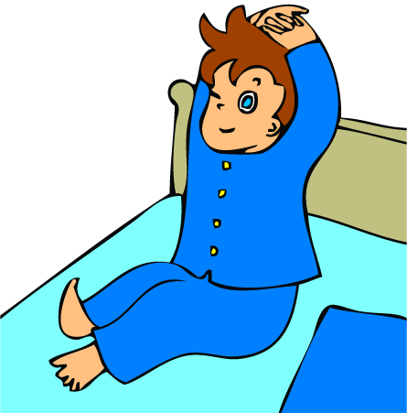

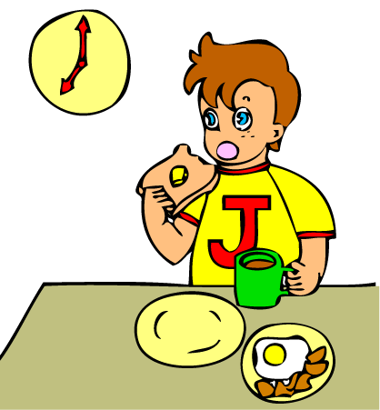
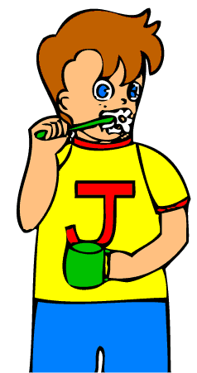


Todays lesson
Life every day
Lesson declaration
And creat emotions

Slide 5
Today we read
Raihan’s routine in the morning
Get up early
Take
breakfast
Wash
face
Brush
teeth
Go to school

Slide 6

I get up early in the morning

Slide 7

I wash my face.

Slide 8

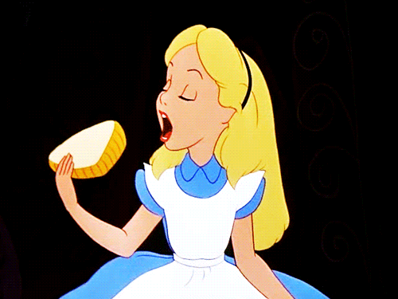
Then I have breakfast.

Slide 9
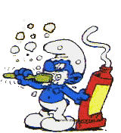
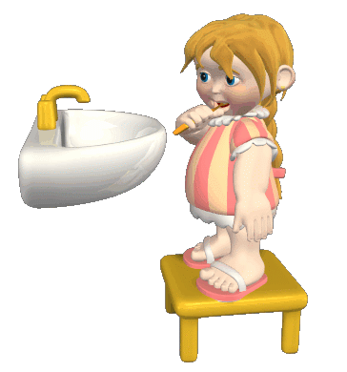
After breakfast I brush my teeth

Slide 10
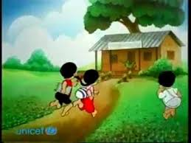
And go to school.

Slide 11

Word meaning
Morning
It means when the sun rises up.

Slide 12
Word meaning
Wase
To clean by water.

Slide 13
Word meaning
Brush
To clean the teeth by toothpeast.

Slide 14
Word meaning
Breakfast
Eating something in the morning.

Slide 15
Loud reading
Connect with book
Students
loud reading
help by the teacher.
Open ur book page no
56
Teachers
loud reading
and discuss
by the lesson.

Slide 16
Silent reading
Open ur book page no-56.
Read silent-A

Slide 17
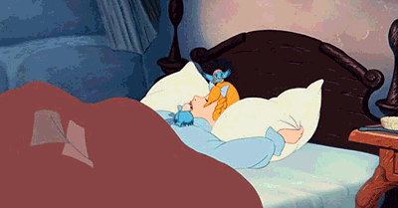
Group work
Team-A
Team-B
Look at
The pictures
and tell about these.
Look at
The pictures
and tell about these.

Slide 18
Matching both side
1)Raihan gets up early in the morning.
2)He washes his face
3)Then he take his breakfast
4)He brush his teeth.
5)Go to school.

Slide 19
Pair work
Look at the pictures and tell me what do u do in the morning?

Slide 20
Indivisiual work
Tell the answer and write these
Q1:When does Raihan get up?
Q2:How many things does he do in the morning?

Slide 21
Good bye

